Slide 1
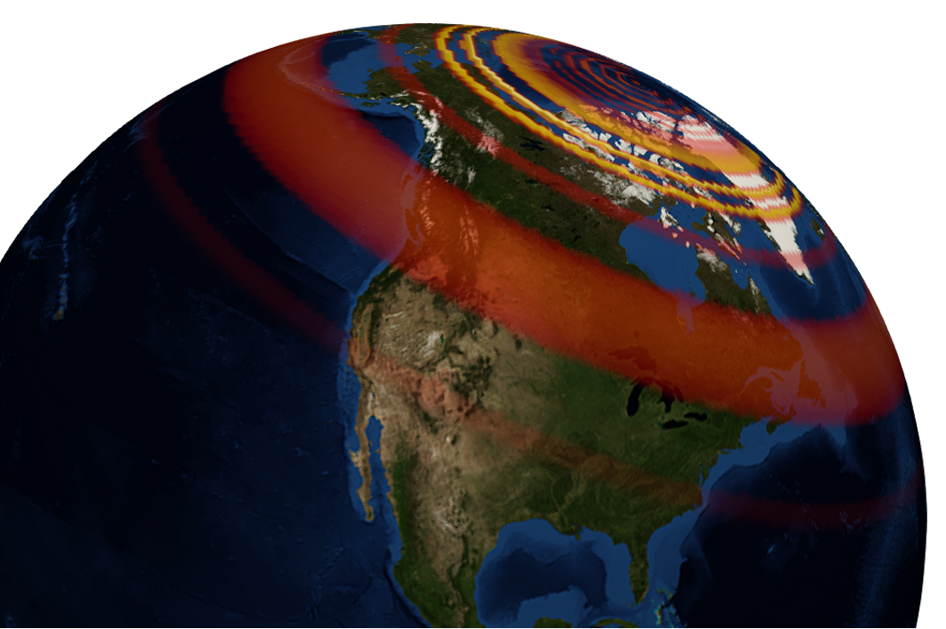
GEOL593: Seismology and Earth Structure, Spring 2023
Lecture 6: Seismic wave propagation 3: Normal modes
2/23/23
Ross Maguire
rossrm@illinois.edu
3014 NHB

Slide 2
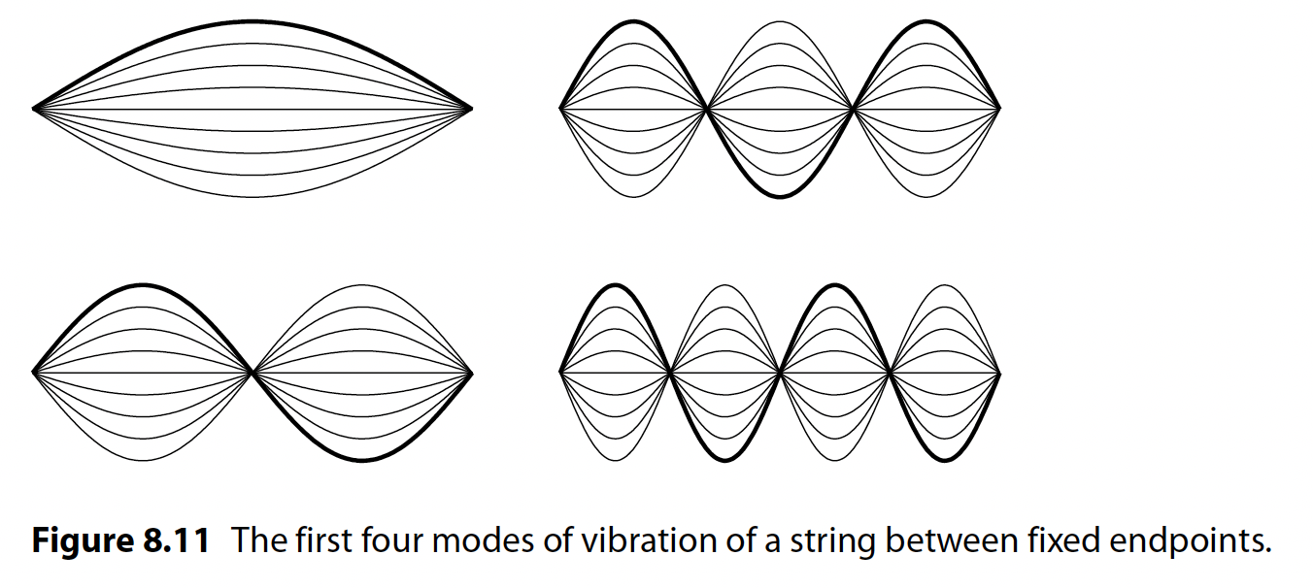
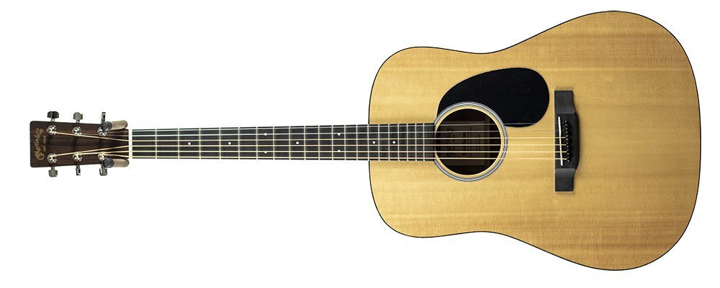
Standing waves on a string
Any motion on a string can be described by a weighted sum of standing waves.
Displacement patterns of standing waves = Eigenfunctions
Resonant frequencies of standing waves = Eigenfrequencies
If you put your fingers over the 12th fret and strum, you will excite the first harmonic

Slide 3
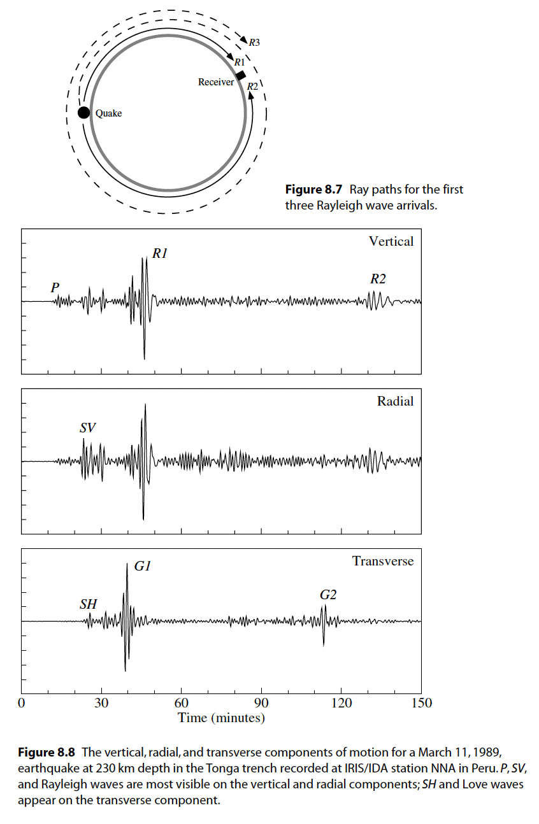
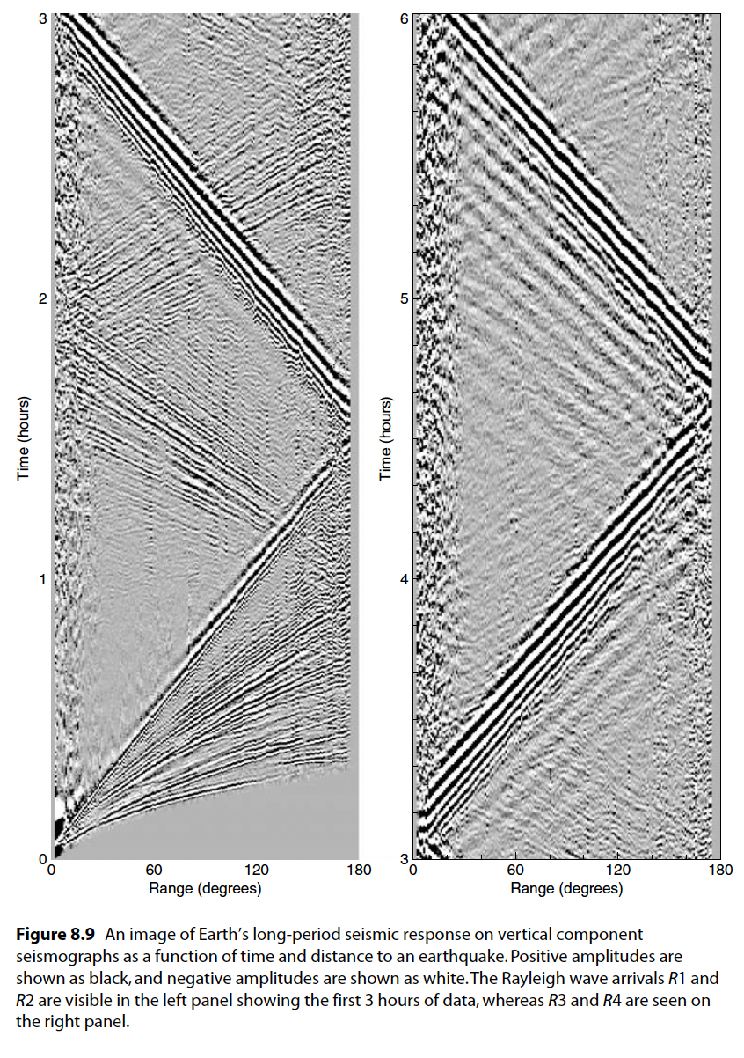
Global surface wave observations
figures from Shearer, 2009

Slide 4
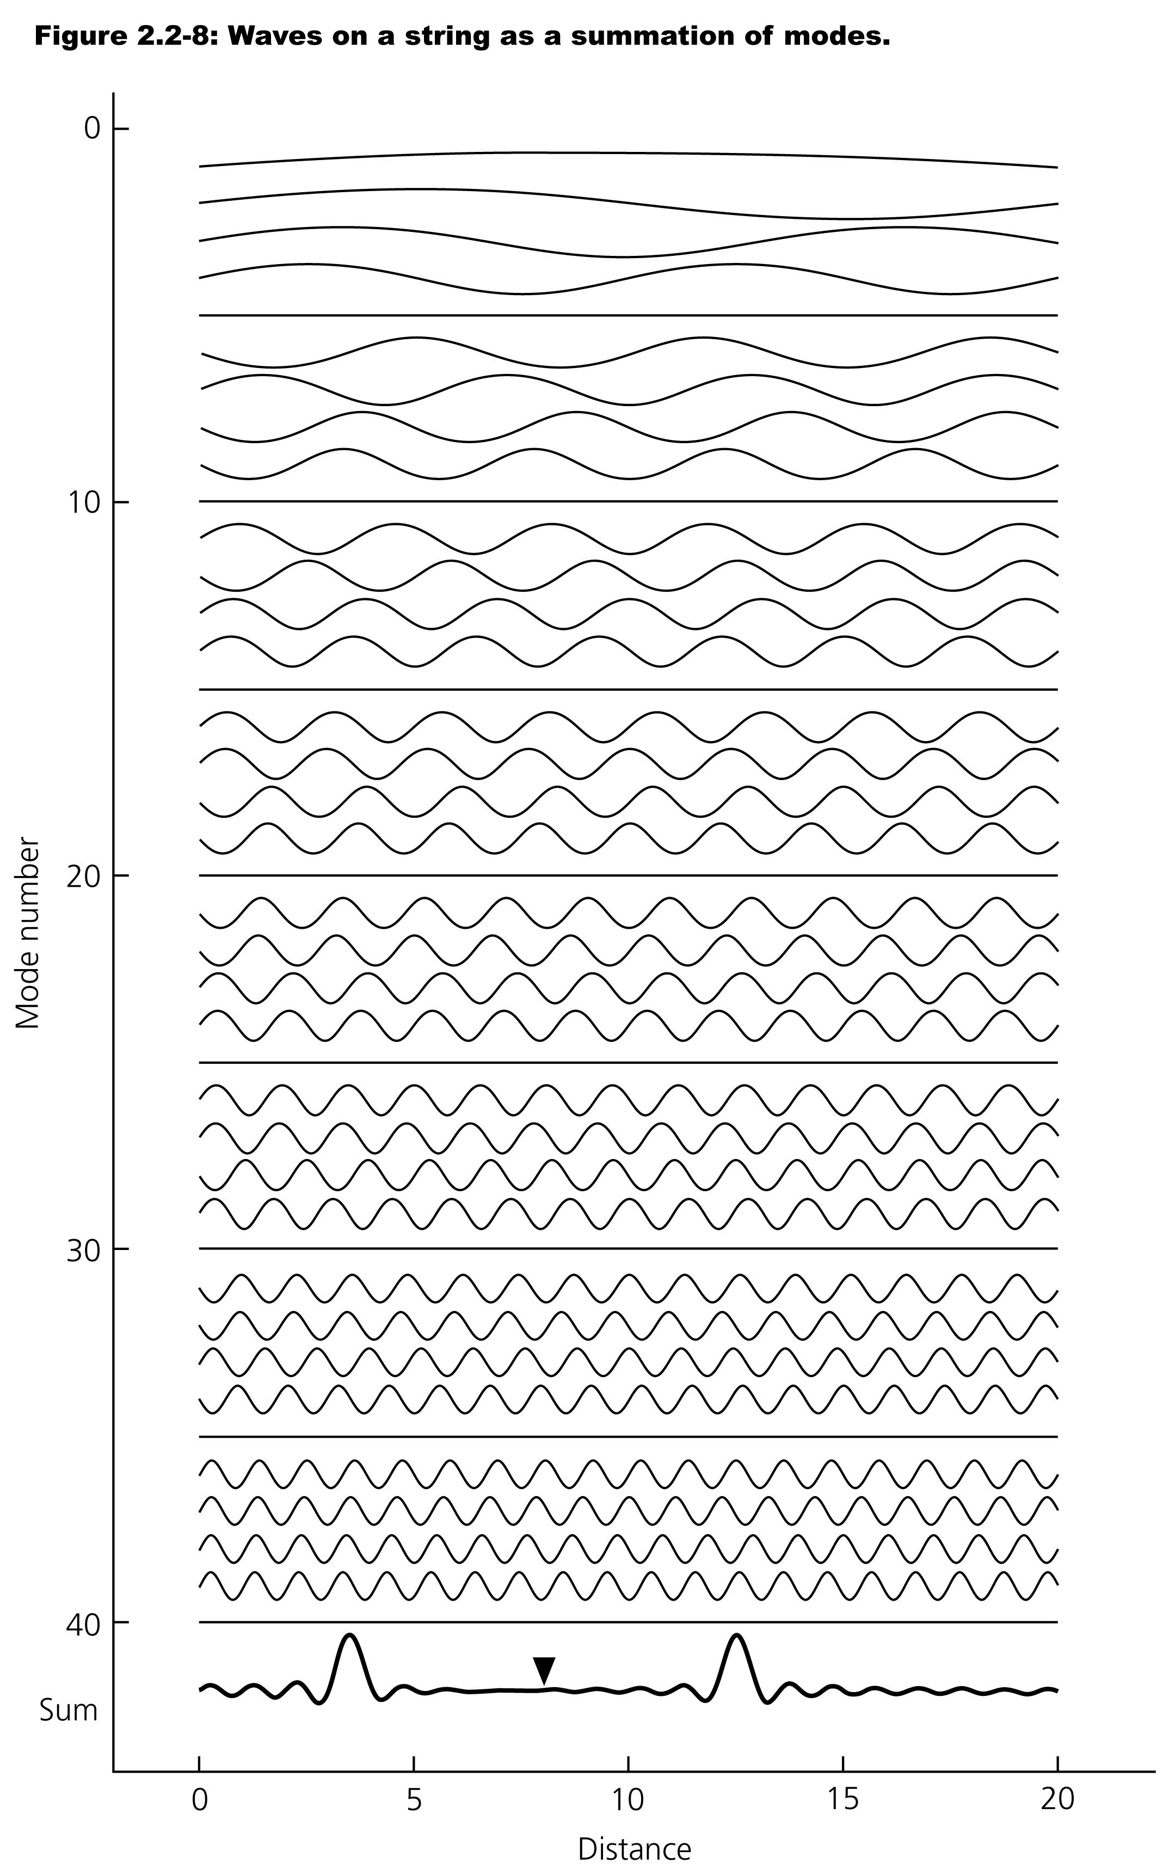
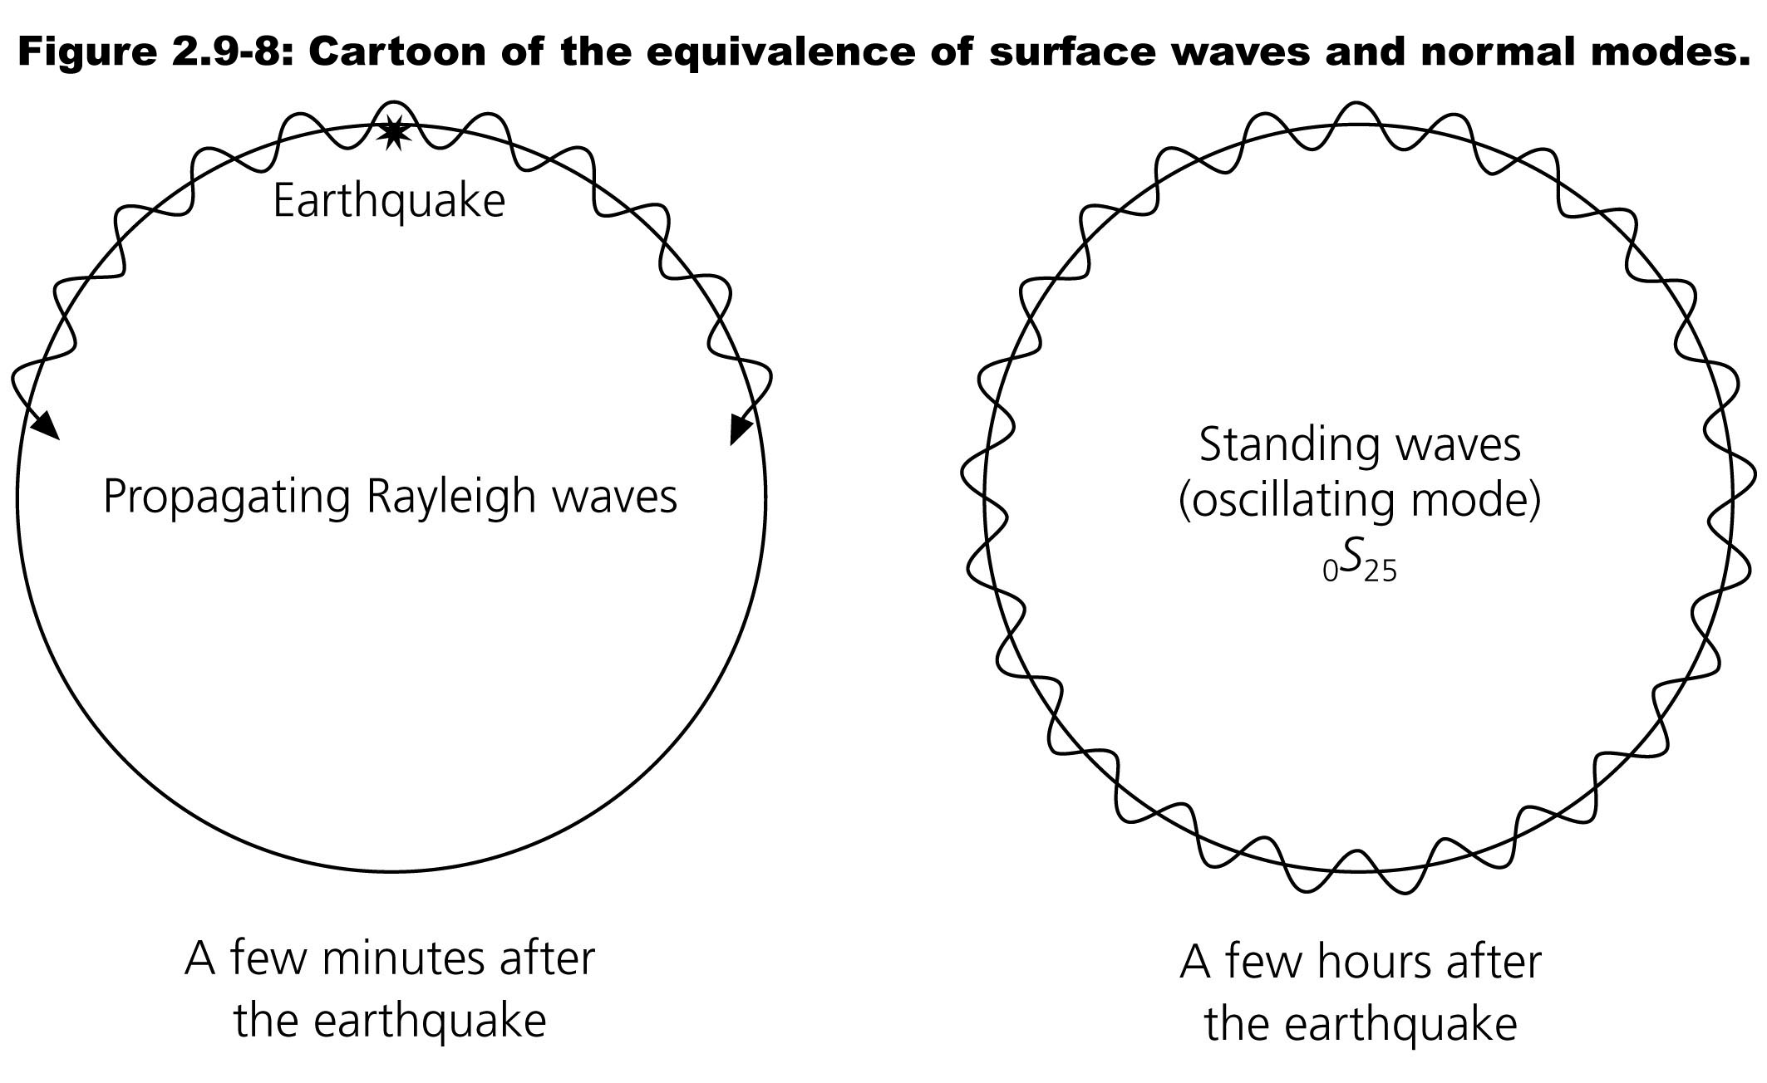
Standing waves on Earth
Any traveling wave can be represented by a superposition of standing waves
Surface waves circling the Earth set up standing waves called “normal modes”

Slide 5
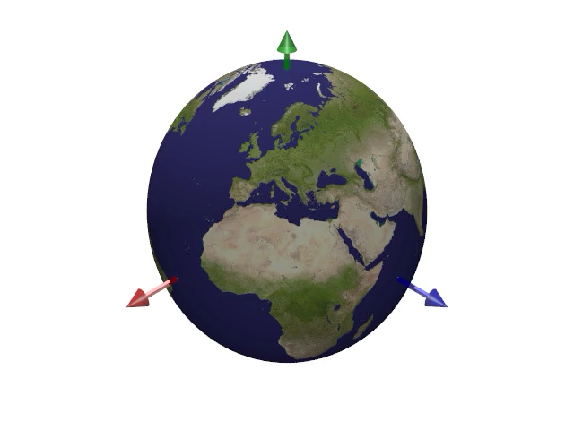
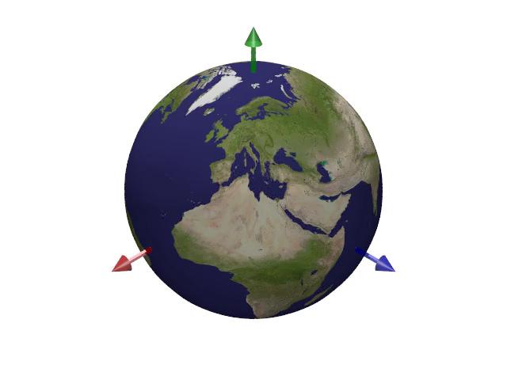
Normal mode patterns (Eigenfunctions)
Each normal mode corresponds to a unique pattern of particle motions on the surface of the Earth
₀S₂
₀T₇ m = 4
https://saviot.cnrs.fr/terre/index.en.html

Slide 6
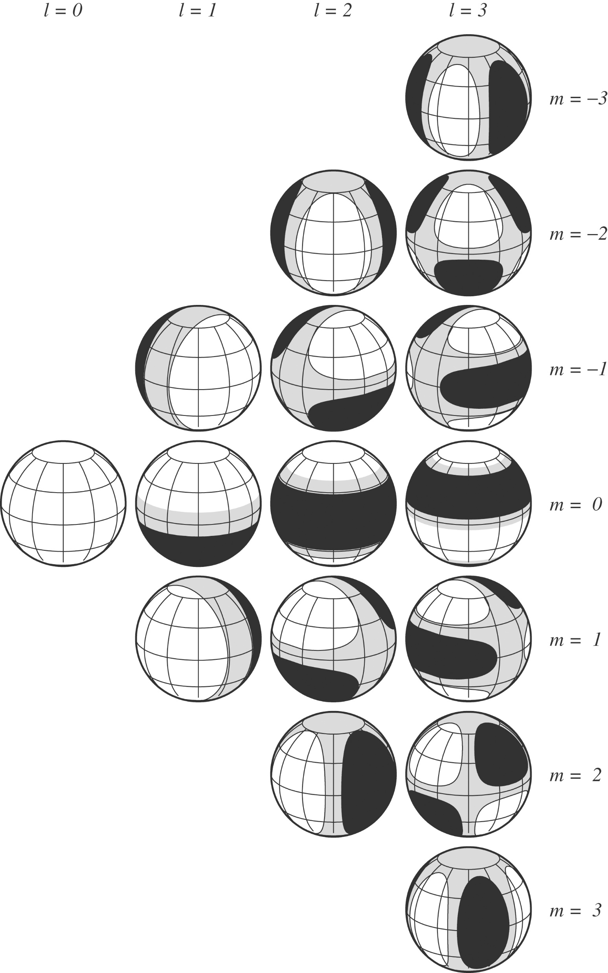
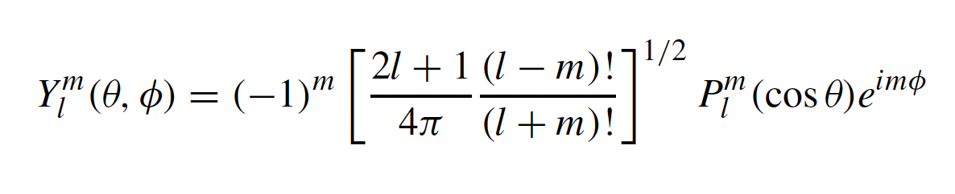
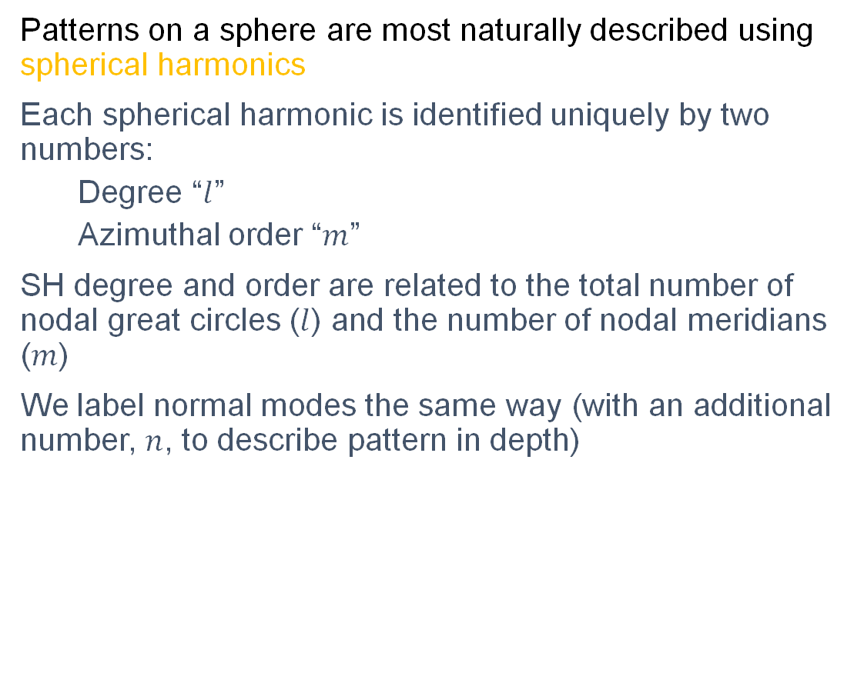
Spherical Harmonics
Patterns on a sphere are most naturally described using spherical harmonics
Each spherical harmonic is identified uniquely by two numbers:
Degree “$l$”
Azimuthal order “$m$”
SH degree and order are related to the total number of nodal great circles ($l$) and the number of nodal meridians ($m$)
We label normal modes the same way (with an additional number, $n$, to describe pattern in depth)
2l + 1 harmonics

Slide 7
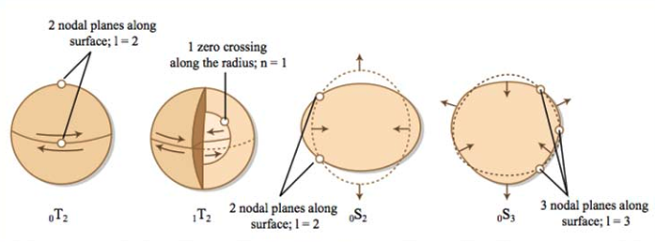
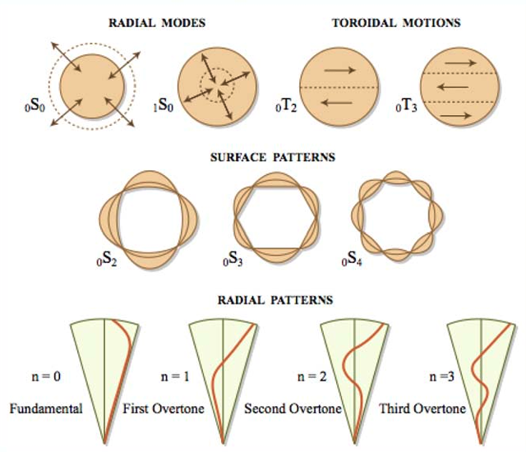
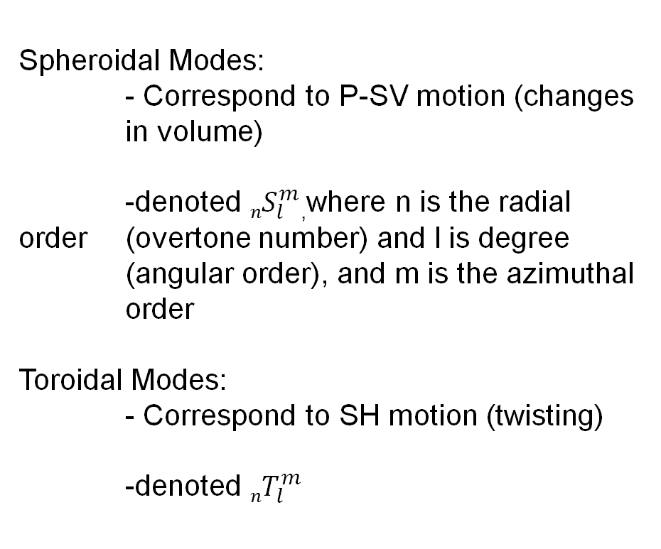
Mode types
Spheroidal Modes:
- Correspond to P-SV motion (changes in volume)
-denoted ${nS}_{l}^{m}$,where n is the radial order (overtone number) and l is degree (angular order), and m is the azimuthal order
Toroidal Modes:
- Correspond to SH motion (twisting)
-denoted ${nT}_{l}^{m}$

Slide 8
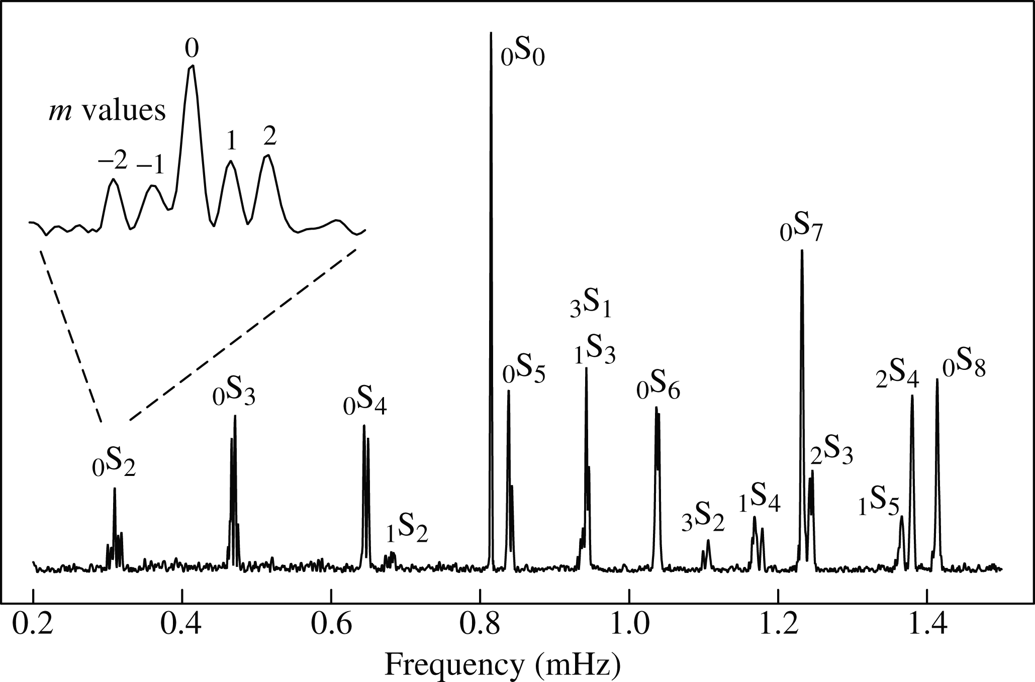
Measuring normal mode frequencies
In the frequency domain (i.e. after taking Fourier Transform) a seismogram shows distinct spectral peaks
Each peak corresponds to a normal mode frequency!
Peaks shift due to rotation, ellipticity and lateral heterogeneity

Slide 9
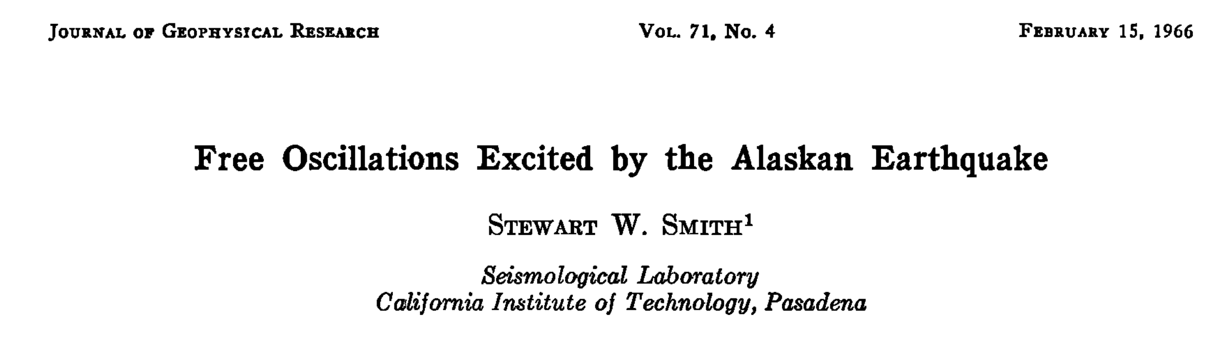
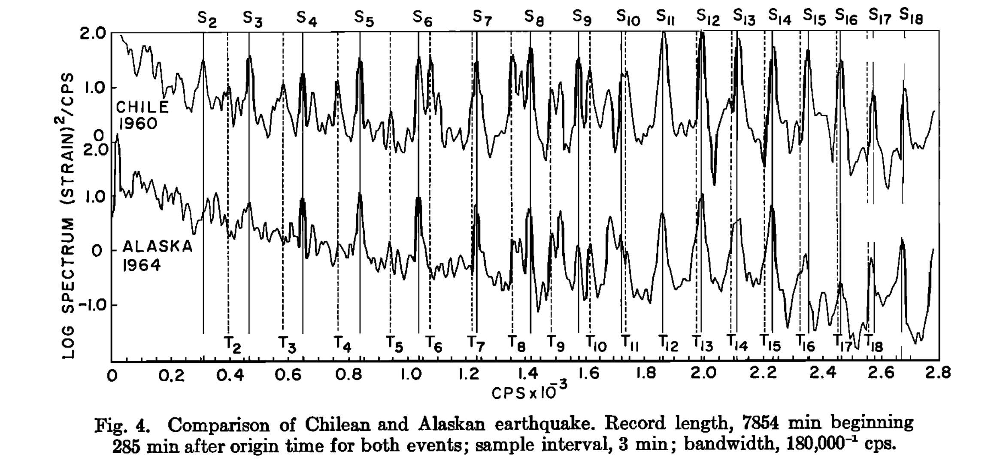

Slide 10
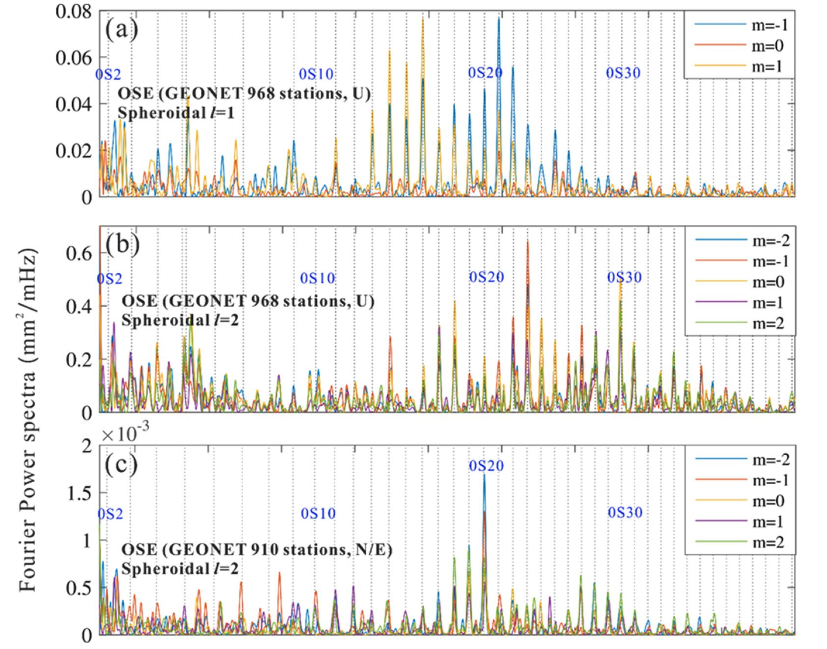
Normal modes from the 2011 Tohoku earthquake
Chu et al. Earth, Planets and Space (2021)

Slide 11
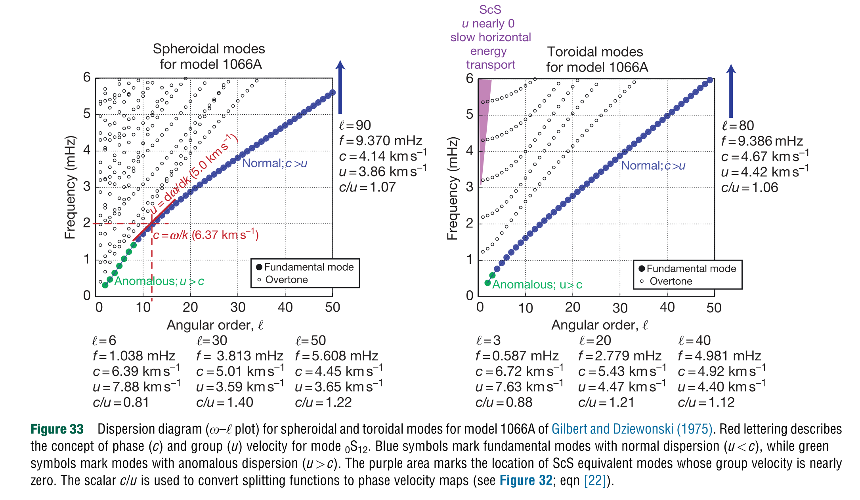
Normal mode frequencies (Eigenfrequencies)

Slide 12
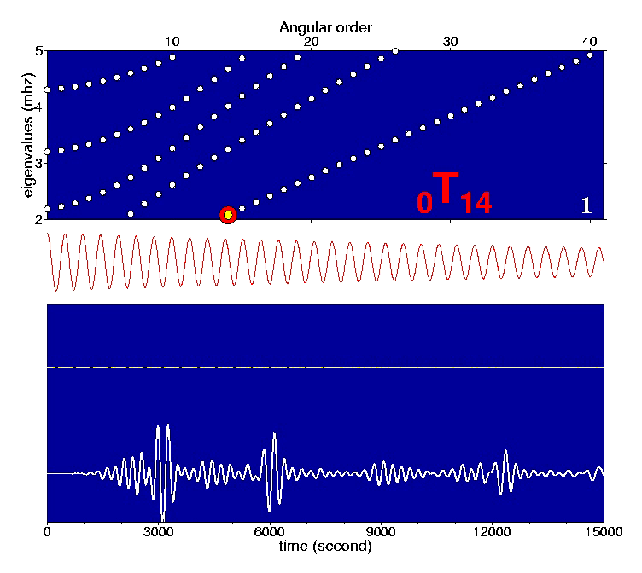
Normal mode synthesis
Any seismogram can be represented by a sum of normal modes
Frequencies of normal modes are discretized
Earth “rings” at a fixed set of frequencies

Slide 13
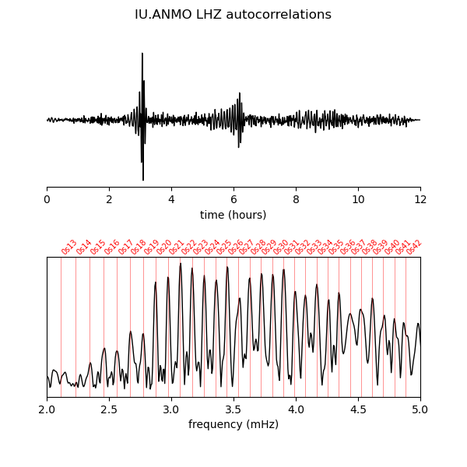
Free oscillations from ambient noise

Slide 14
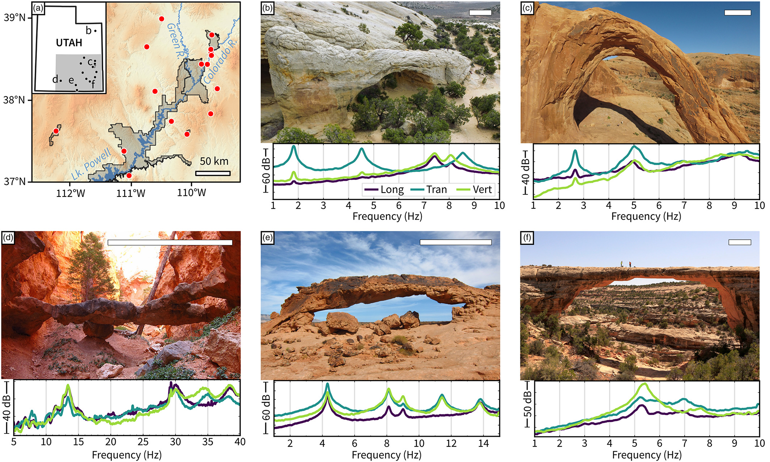
Normal modes of Arches National Park structures
Geimer et al. 2020

Slide 15
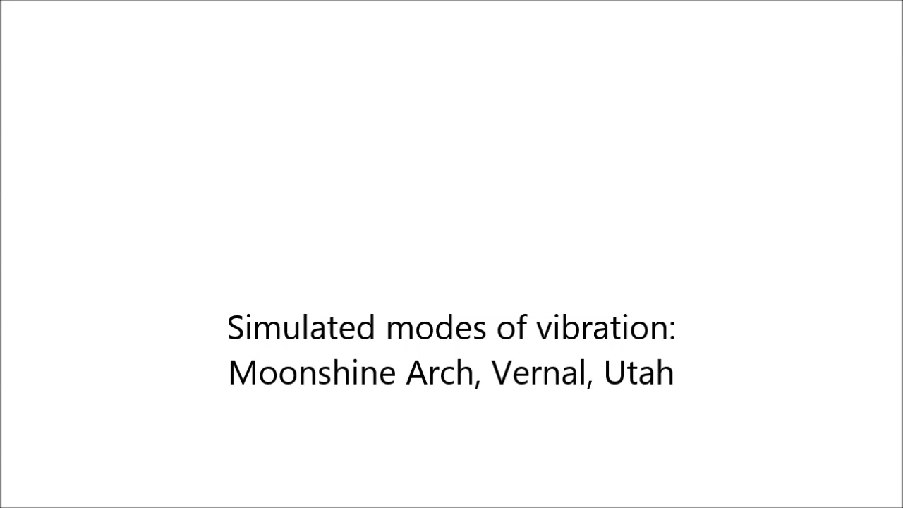
Normal modes of Arches National Park structures

